Slide 1
Pattern Name | Driver Code | Abstract Base Class | Interface | Other
Object Pool | Yes | Yes |  | Object Pool class API
Prototype | Yes |  |  | Class that implements Cloneable and has the clone() method
Factory Method | Yes | Yes
Abstract Factory and Simple Factory | Yes |  | Yes
Builder | Yes |  |  | Diagram, Class that implements the interface with the construct method
Singleton | Yes | Yes |  | Think twice!
Observer |  |  | Subject, Observer, Filter | Data structure to store observers and filters
State |  |  | State Interface | State Diagram
Design Patterns: requirements for exam/quiz
Programming Design Patterns
Notes:
Mark/tag pattern: mention the name of the pattern and write code for an empty interface.

Slide 2
Object Pool API
public class MyXYZObjecttPool {
public void addXYZObject(XYZObject xyz);
public XYZObject borrowObject();
public void returnXYZObject(XYZObject obj);
public setFactory(MySpecializedObjectFactory fac);
public void clear();
public void close();
public int getNumActive();
public int getNumIdle();
public void invalidateObject(XYZObject obj);
// … more methods
}
// Exam: replace XYZ with whatever name is relevant to the design problem
// Exam: it will suffice to show just 5 methods of the interface
Programming Design Patterns

Slide 3
Object Pool – Driver Code
MyXYZObjectPool myObjPool= new MyXYZObjectPool();
MyXYZObject myXYZ= myObjPool.borrowObject();
// Note that an object pool need not always be Singleton. It is possible for an application to
// have multiple pools. For example,
// a pool instance specialized for security
// a pool instance specialized for UDP connections
// a pool instance specialized for TCP connections
// etc.
Programming Design Patterns

Slide 4
Prototype Pattern
public class DarkHalloweenRoom implements Cloneable {
public Object clone() {
return super.clone();
// alternatively, you can provide a deep copy
// implementation here
}
}
// Driver Code, assumes existingRef needs to be cloned
Cloneable anotherDarkRoom = (DarkHalloweenRoom)existingRef.clone();
Programming Design Patterns

Slide 5
Factory Method
  public abstract class PizzaStore {
  …
  public final Pizza orderPizza(Choices userChoices) {
  Pizza pizza;
  // Replaces the factory method
  pizza = createPizza(userChoices);
  pizza.bake();
  …
  // all methods that need to be invoked on the product
  return pizza;
  }
  protected abstract Pizza createPizza(Choices userChoices);
  }
Programming Design Patterns

Slide 6
Driver Code: Factory Method
PizzaStore nyStore = new NYPizzaStore(…);
Pizza p = nyStore.orderPizza(myChoices);
Programming Design Patterns

Slide 7
SimpleFactory
public interface SimpleXYZFactory {
public XYZ createXYZ(Choices userChoices);
}
// replace userChoices with parameters relevant to the design
// Example of userChoices would be an enum that specifies type and style of pizza
Programming Design Patterns

Slide 8
Simple Factory: Driver Code
SimpleXYZFactory xyzFactory = new MySimpleXYZFactory();
XYZ myXYZobj = xyzFactory.create(myChoice);
Programming Design Patterns

Slide 9
AbstractFactory
public interface XYZComponentsFactory {
public ABC createABC(Choices userChoicesForABC);
public DEF createDEF(Choices userChoicesForDEF);
public XYZ createXYZ(Choices userChoicesForXYZ);
}
// replace ABC, DEF, XYZ with components relevant to the design problem
// Note that ABC, DEF, and XYZ should be a family of related objects
Programming Design Patterns

Slide 10
Abstract Factory: Driver Code
XYZComponentFactory xyzCompFactory = new MyXYZComponentFactoryImpl();
XYZ myXYZobj = xyzCompFactory.createXYZ(myChoices);
Programming Design Patterns

Slide 11
Builder Pattern: Driver code
  BUAlumnus bGates =
  new BU2015Alumnus(“Soccer: 4.00 PM”,
  “Prof. Tinkerputt: Noon”,
  “Lunch: C4”,
  “4.00 PM Nature Tour”,
  “Dinner: PS Restaurant”);
  AlumniScheduleWorkshop shop =
  new BU2015ScheduleWorkshop();
  shop.construct(bGates);
  }
Programming Design Patterns

Slide 12
Builder Pattern: Workshop implementation
  public class BU2015ScheduleWorkshop implements AlumniScheduleWorkshop {
  // …
  public void construct(BUAlumnus m) {
  m.bookSoccerGameTickets();
  m.setUpProfAppointment();
  m.setupNaturePreserveTour();
  m.makeDinnerReservations();
  }
  }
Programming Design Patterns

Slide 13
Observer Pattern
public interface Subject {
public void registerObserver(Observer o, Filter f);
public void removeObserver(Observer o);
public void notifyObservers();
}
public interface Observer {
public void update(Message m);
}
public interface Filter {
// parameter may vary according to the problem
boolean check(String filterString);
}
Data structure to store the observers and filters in the SubjectImpl: HashMap
Programming Design Patterns

Slide 14
State Interface
public interface State {
public void insertQuarter();
public void ejectQuarter();
public void turnCrank();
public void dispense();
}
Programming Design Patterns

Slide 15
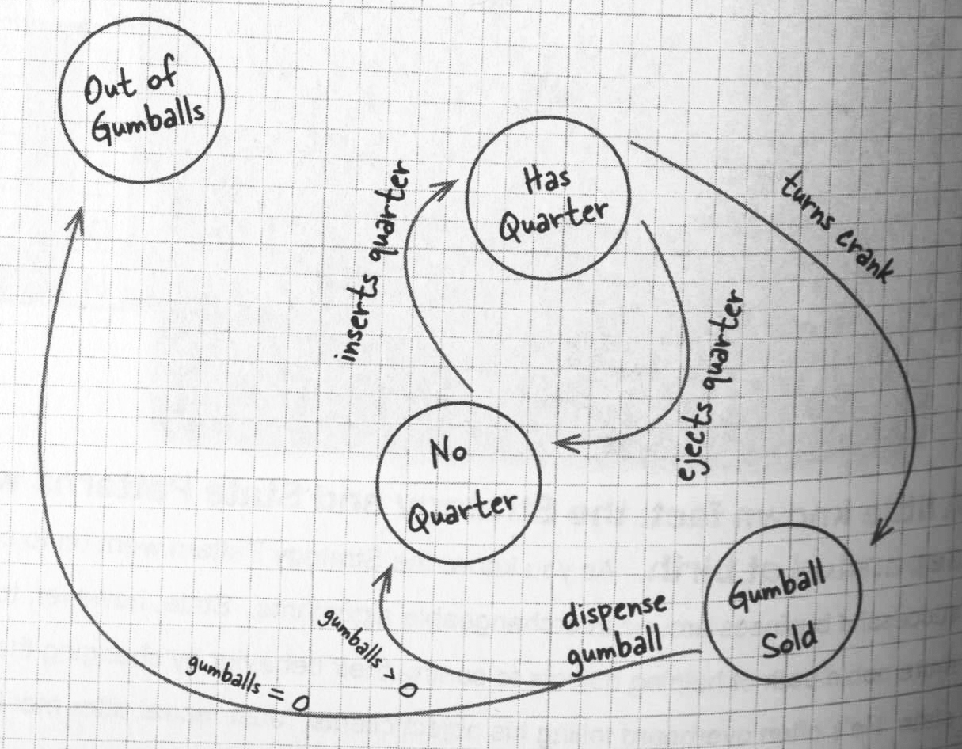
State diagram
Programming Design Patterns

